Slide 1
Case 2 “Ginger” “I keep getting cavities, and I hate dentists”

Slide 2
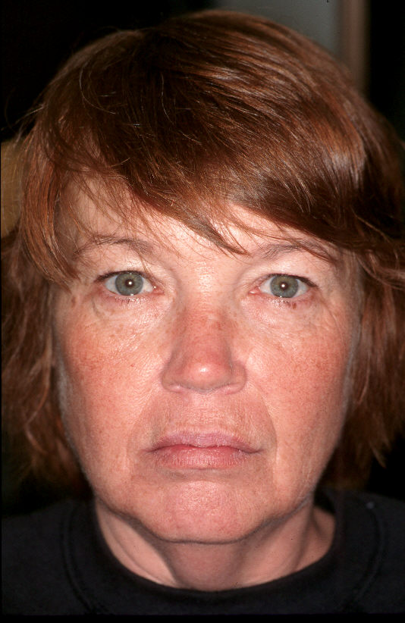
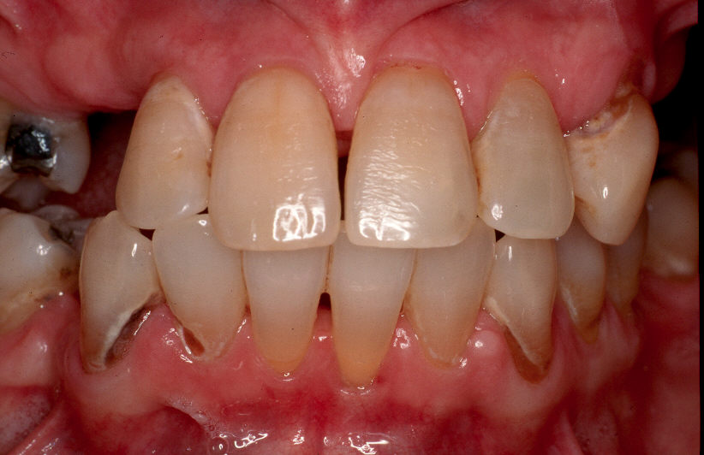
Chief Complaint
"I keep getting cavities. I want to be able to smile and eat without pain"

Slide 3
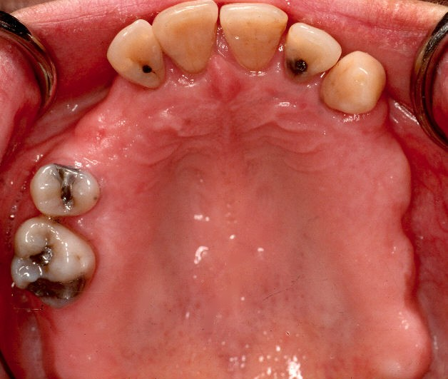
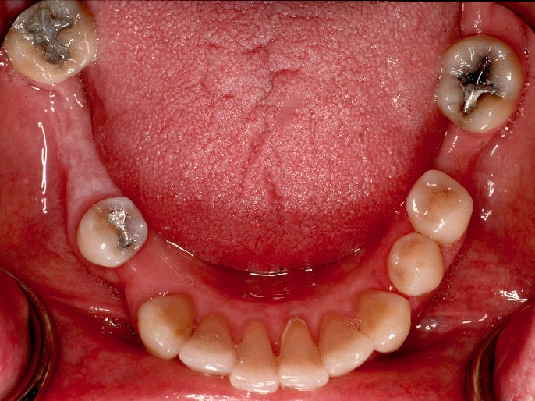
Present Illness and dental history
45 year old single Caucasian female
Recent dental history involves multiple visits to the dentist for toothaches
Several teeth have abscessed and she opted for extractions because of her fear of “root canals” and severe dental phobia.
Wants to be able to keep her teeth. Wants to be put to sleep to have her treatment.

Slide 4
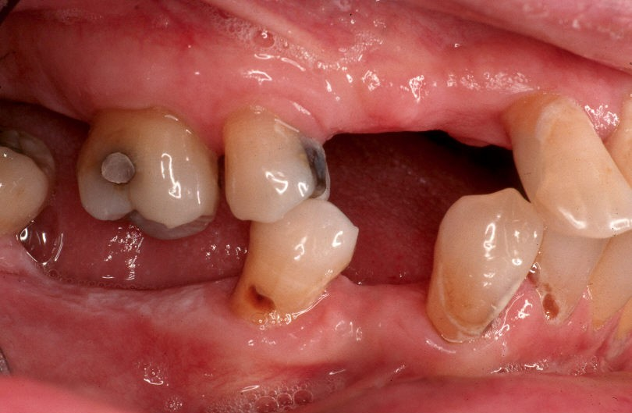
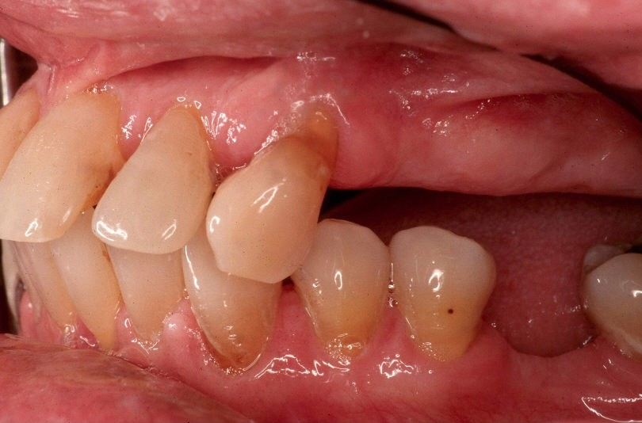
Medical History
History of depression, anxiety disorder, panic attacks, and ADHD. Severe dental phobia.
Insomnia, seasonal allergies and mild asthma. History of bruxism; wears a bitesplint but it doesn’t fit well since losing so many teeth.
Occasional pain in right TMJ.

Slide 5
Medical History continued
History of GI problems (GERD; intolerance to artificial sweeteners)
Oral mucosa is very sensitive to spicy food, toothpaste, mouthwashes
Complains of dry sensitive mouth

Slide 6
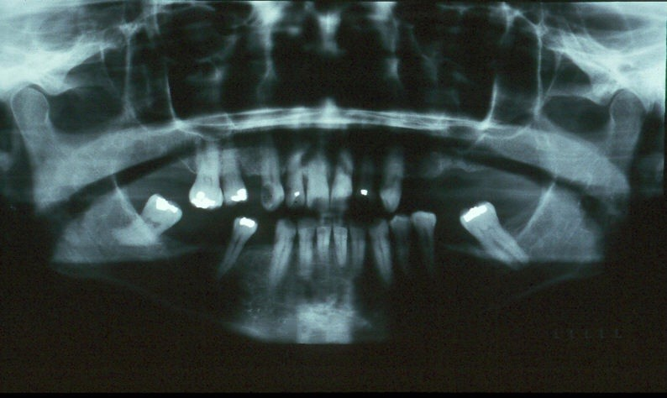
Medical History continued
Current medications: Prozac, Adderall, Xanax, Sonata, Tri-Levlen, Allegra, Nasonex, Flovent
Takes OTC sleep medications and cold and sinus meds as needed

Slide 7
Personal/Social History
Lives at home with elderly parents; clerical worker in a grocery store; concerned that her appearance will affect her ability to keep her job.

